Slide 1
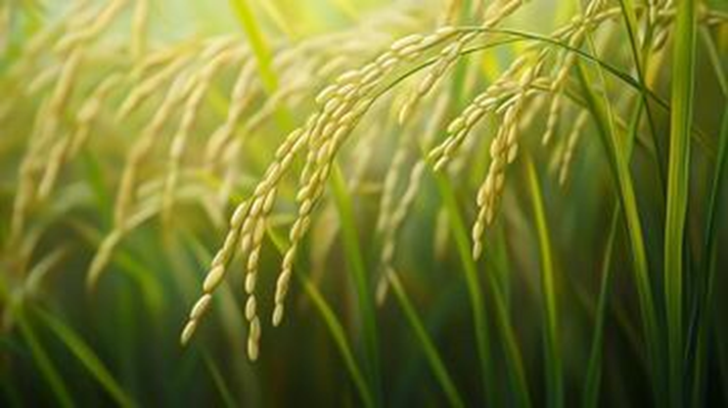
CROP RECOMMENDATION PREDICTION USING CLASSIFICATION MODEL
Submitted By:
ANGEL JACOB
DATA ANALYTICS

Slide 2
INTRODUCTION
Agriculture is the backbone of Indian economy
Crop recommendation system helps farmers make informed decision about which crop to grow based on various factors such as nitrogen, phosphorus, potassium levels in the soil, as well as environmental conditions like temperature, humidity, pH and rainfall.
By training and comparing models such as Logistic Regression, Decision Tree, and Random Forest, we aim to find the most accurate method for predicting suitable crops.

Slide 3
OBJECTIVES
To predict suitable crops based on soil and environmental conditions
To analyse various machine learning models for improving prediction accuracy.
To enhance crop yield, minimize resource wastage and increase profitability for farmers.

Slide 4
DESIGN OF WEBSITE
The website is designed as an interactive and user-friendly interface using Gradio, allowing users to easily predict crop based on key input parameters.
Users are presented with a simple form where they can input values such as nitrogen ,phosphorus, potassium, temperature, humidity, pH and rainfall.
Once submitted, the form uses a trained machine learning model, like Random Forest, to instantly predict and display the most suitable crop.

Slide 5
PROCESS ON DATASET
Dataset Description
Pre-processing Steps
Model Training
Gradio Interface
Save model to the pickle
Model Selection

Slide 6
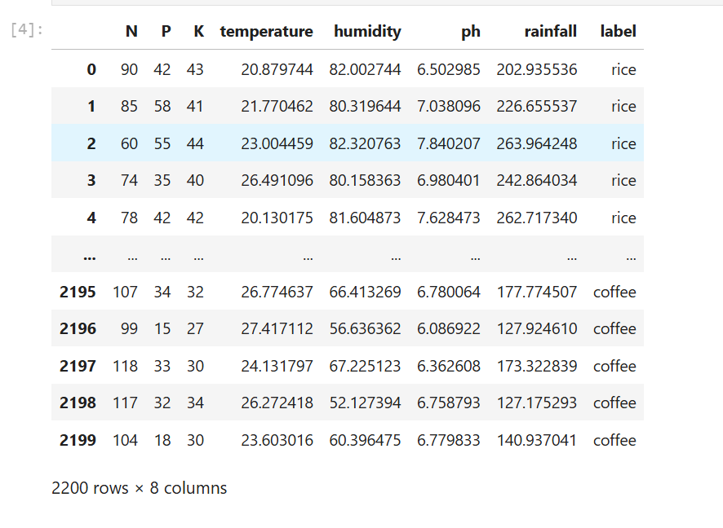
DATASET

Slide 7
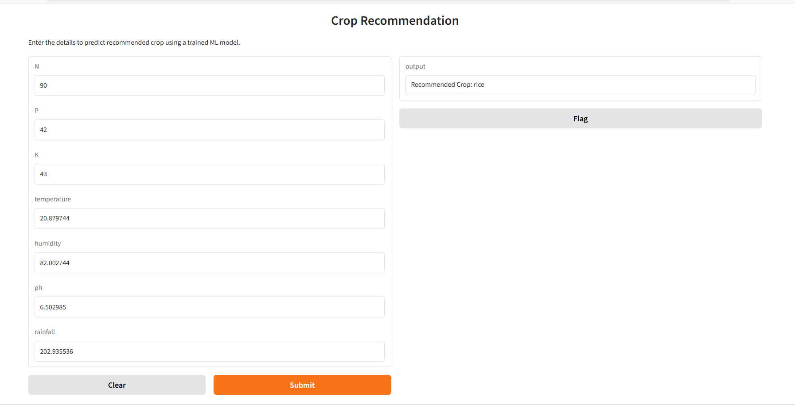
USER INTERFACE

Slide 8
COMPARISON TABLE
Models | Accuracy score | Precision | Recall | F1 score
Logistic Regression | 94% | 0.94 | 0.95 | 0.94
Decision Tree Classifier | 98% | 0.98 | 0.98 | 0.98
Random Forest Classifier | 99% | 0.99 | 0.99 | 0.99

Slide 9

APPLICATIONS
Smart farming support
Decision support for new farmers
Integration with mobile apps

Slide 10
RECOMMENDATIONS
User feedback mechanism
Mobile application development
Customized recommendations

Slide 11
CONCLUSION
Throughout this project ,we have developed crop recommendation system that provide farmers with personalized recommendations for their specific agricultural conditions.
Our system not only addresses the challenges faced by traditional method but also hold importance for future of agriculture. Together , we are revolutionizing agriculture for a more resilient and prosperous future.
By leveraging Random Forest Classification, this system achieves an impressive accuracy of 99.31%.
Reference
Kaggle: https://www.kaggle.com/datasets/atharvaingle/crop-recommendation-dataset

Slide 12
THANK YOU

